Slide 1
Task-13 Deploy ci/cd pipeline to production SWIGGY-APP done by varaprasad

Slide 2
What is Jenkins?
Jenkins is a tool that is used for automation. It is mainly an open-source server that allows all the developers to build, test and deploy software. It is written in Java and runs on java only. By using Jenkins we can make a continuous integration of projects(jobs) or end-to-endpoint automation.
What is Jenkins CI/CD Pipeline?
Jenkins CI/CD stands for Continuous Integration / Continuous Deployment first let us try to understand what is a pipeline. In computing, a pipeline is a set of stages or processes linked together to form a processing system. Each stage in the pipeline takes an input, processes it in accordance with a set of rules, and then sends the outputs to the stage that follows. Frequently, the pipeline’s overall output is its final step’s output. like the procedures outlined below.
Test code
Build Application
Push Repository
Deploy to Server
All the steps mentioned above will perform in sequence one after the other if any step/stage get failed it will not move forward to another step/stage until the previous step got a success. To master Jenkins and its integration in CI/CD pipelines, the DevOps Engineering – Planning to Production course provides detailed lessons and real-world projects.

Slide 3
What is Jenkins Continuous Integration (CI)?
Jenkins Continuous integration means whenever new code is committed to remote repositories like GitHub, GitLab, etc. Continuous Integration (CI) will continuously build, tested, and merged into a shared repository.
Benefits of Continuous Integration (CI)
We can maintain the reports of the projects
Deployments can be made within the given time
Bugs can be found quickly.
What is Jenkins Continuous Deployment/Delivery (CD)?
Continuous Deployment
Continuous Deployment means automating the further stages of the pipeline automatically or manually deploying the application/code to different environments like Dev, Test, and Production. Automating the build is the main component of Continuous Integration and Continuous Deployment.
Continuous Delivery
Each and every build that passed all automated tests and was able to be fully automated and delivered into production only required one click of human intervention is called Continuous Delivery.

Slide 4
SONARQUBE JENKINS INTEGRATION
What is Sonarqube?
SonarQube is an open-source platform that is used to inspect code quality continuously. It performs automated code reviews by scanning the code for possible issues like bugs, vulnerabilities, bad code practices, security risks. and way more. SonarQube supports a vast number of programming languages and plugs into CI/CD pipelines with the help of which the quality of the code is continuously checked, and necessary actions are done to improve it.
Some Key Features In Sonarqube:
Static Code Analysis
Code Quality Metrics
Security Vulnerabilities
Language Support
Integration with CI/CD Tools

Slide 5
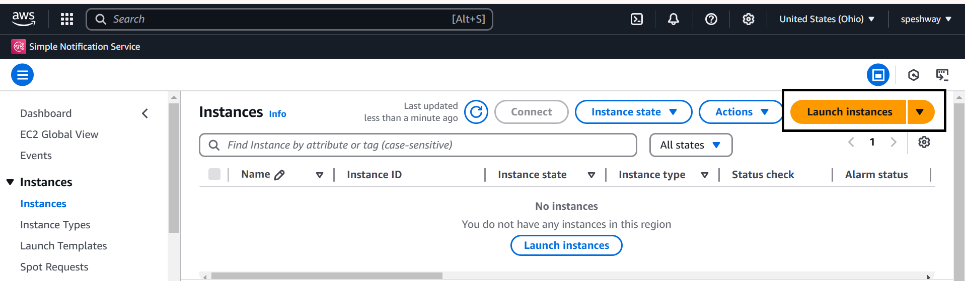
Sonarqube Jenkins Integration:
Step-1:
First Need to Create one EC2 instance in AWS Console
First click on launch instance in EC2 dashboard.

Slide 6
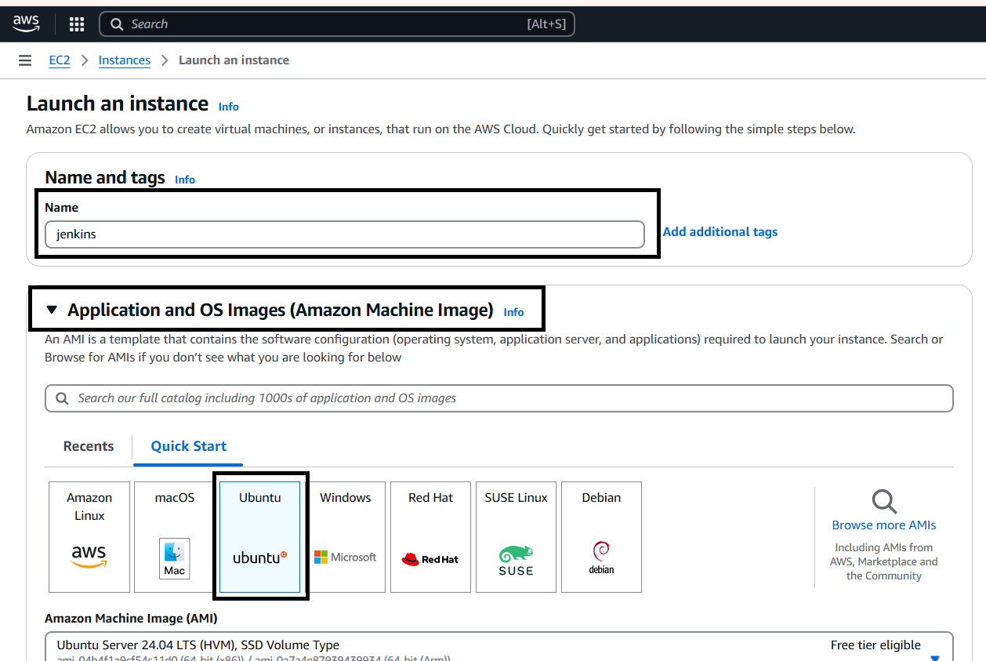
After click on the Launch Instance Need to provide Name and select AMI (like Linux,Ubuntu etc…,)

Slide 7
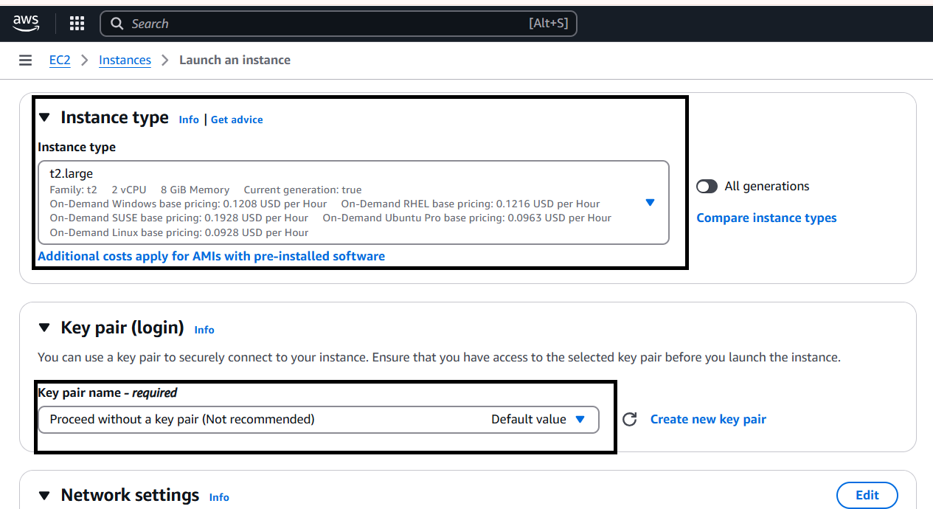
Then select Instance Type as t2.large and select select any existing key pair or create new key by click create new key pair.

Slide 8
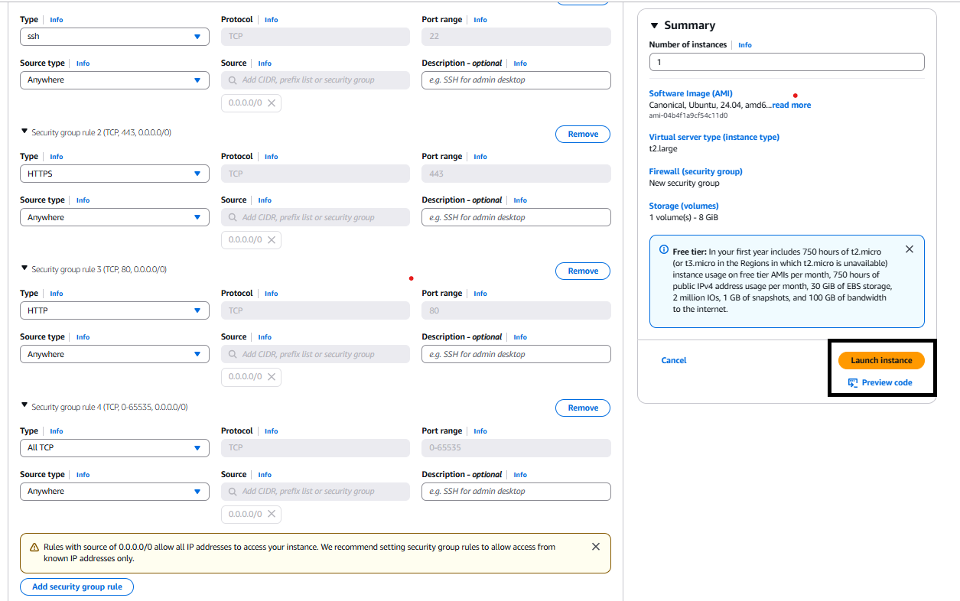
Then go the Network settings and then Allow the HTTP & HTTPS then click on Edit then add security group with All TCP then click on Launch Instance.

Slide 9
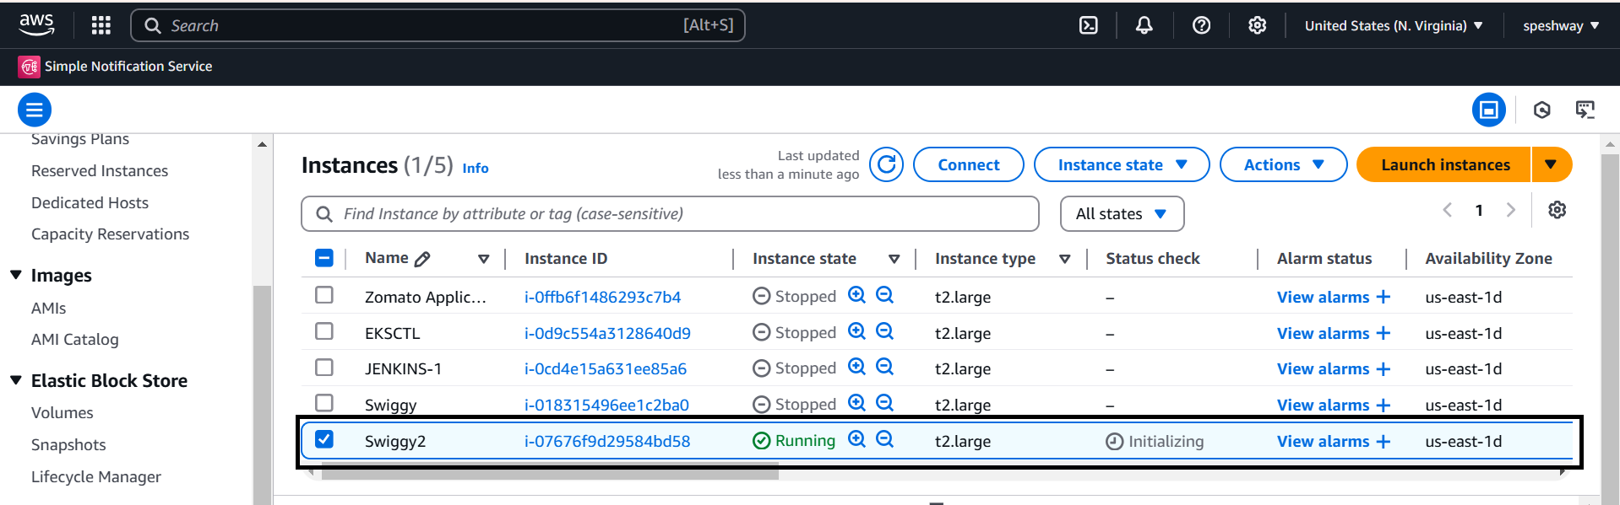
After the Instance Created then Connect the instance with any tool(GIT,Mobaxterm etc..,) with SSH Key .

Slide 10
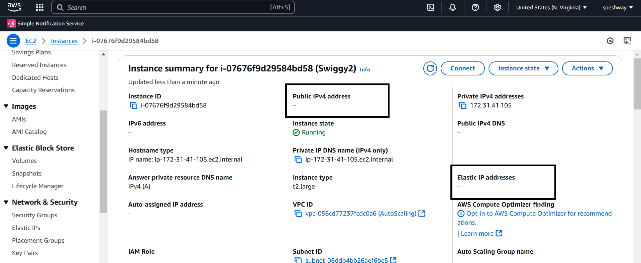
Instance has been created but public ip : is not created.
Why means here I take permanent ip address is elastic ip: address.

Slide 11
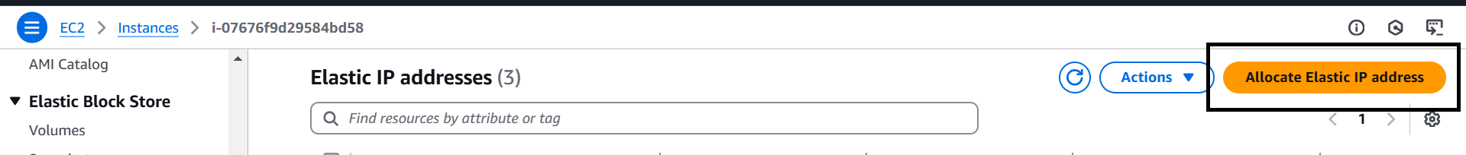
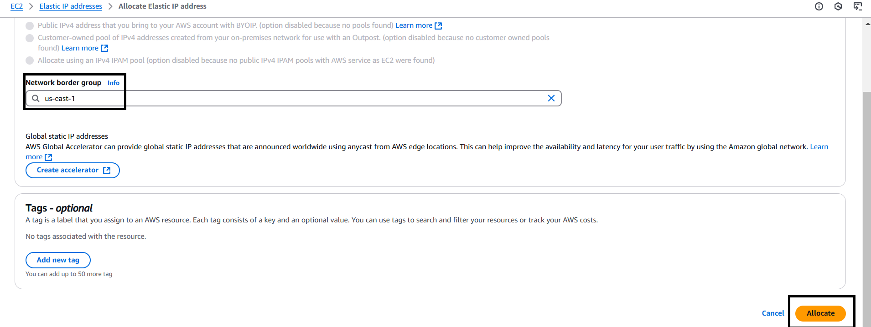
Here I show how to generate elastic ip : address.
And next Check network border group and next allocate.

Slide 12
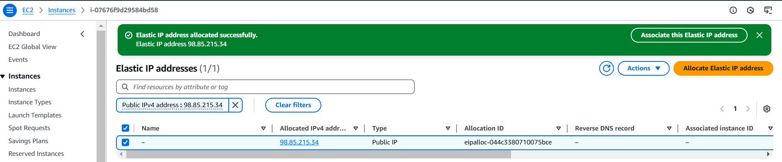
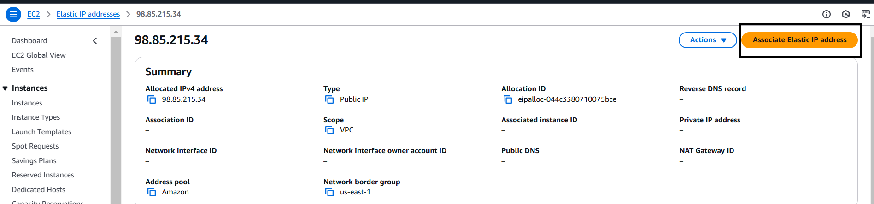
Elastic ip : has been created its shown below.
And next click on ip address and next associate elastic ip : address.

Slide 13
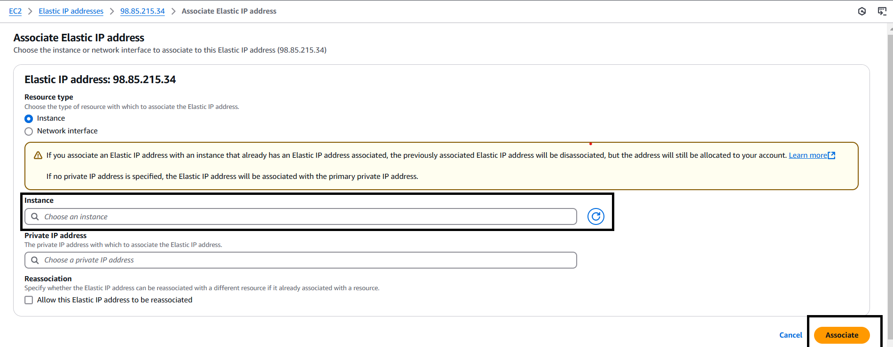
Here attach instance and which is running is running state .
And next click on associate.

Slide 14
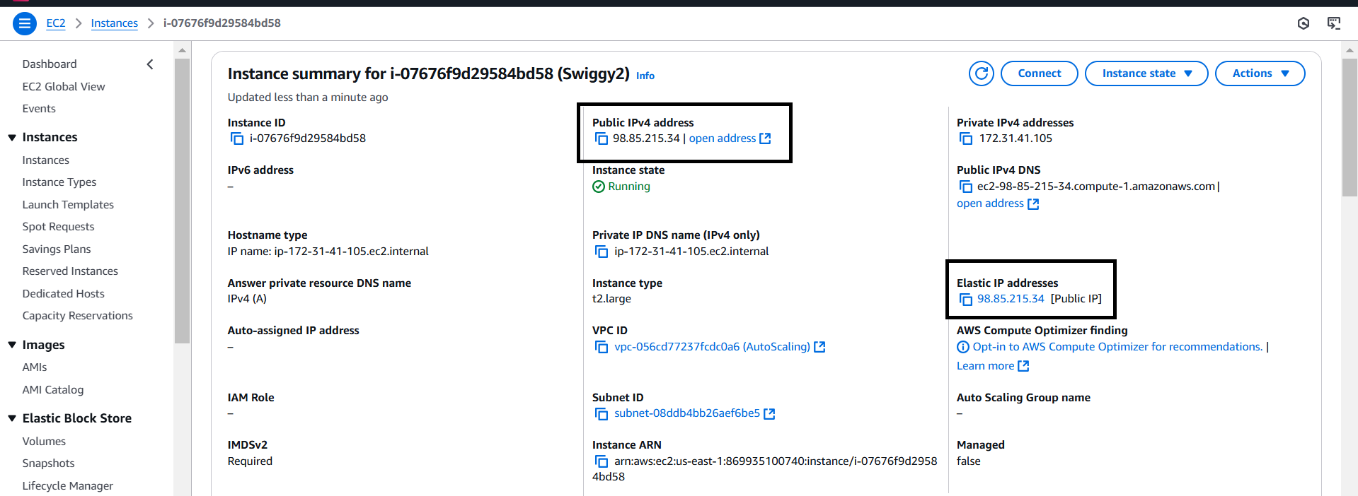
Here it shows connected elastic ip: address its shown below.

Slide 15
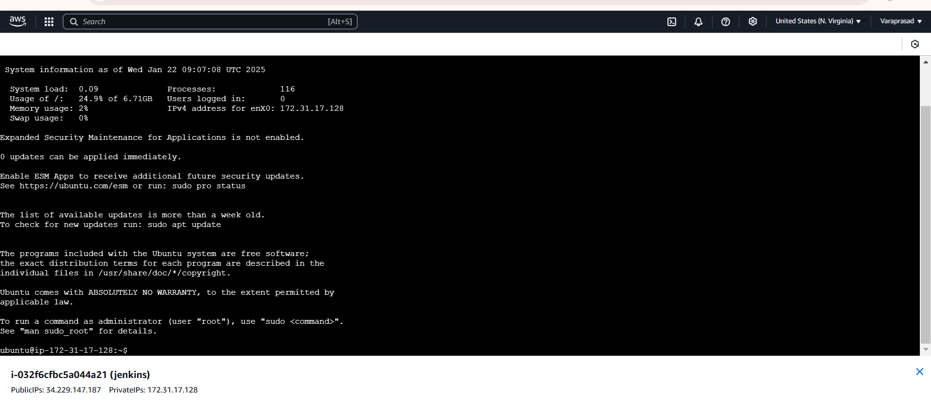
After Copy the SSH link paste that in any tool (GIT,Mobaxterm etc..,) to connect with AWS.

Slide 16
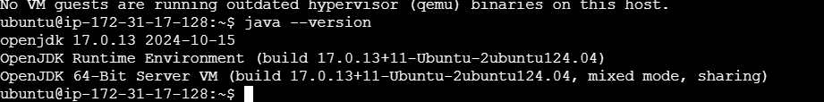
Step-2:
Now install Java,Maven,Jenkins,sonarqube and Docker in the instance for Integration.
To Install Jenkins follow below commands.
sudo apt update -y
sudo apt upgrade –y
sudo wget -O /usr/share/keyrings/jenkins-keyring.asc \ https://pkg.jenkins.io/debian-stable/jenkins.io-2023.key
echo "deb [signed-by=/usr/share/keyrings/jenkins-keyring.asc]" \ https://pkg.jenkins.io/debian-stable binary/ | sudo tee \ /etc/apt/sources.list.d/jenkins.list > /dev/null
sudo apt-get update
Now need to Install Jdk in Instance for that use
sudo apt install openjdk-17-jre-headless
Java –version

Slide 17
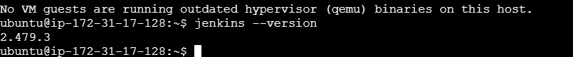
Then need to Install Maven In the Instance using
sudo apt install maven -y
Then need to Install Jenkins before install need to add Keys for Jenkins
curl -fsSL https://pkg.jenkins.io/debian-stable/jenkins.io-2023.key | sudo tee \ /usr/share/keyrings/jenkins-keyring.asc > /dev/null
echo deb [signed-by=/usr/share/keyrings/jenkins-keyring.asc] \ https://pkg.jenkins.io/debian-stable binary/ | sudo tee /etc/apt/sources.list.d/jenkins.list > /dev/null
sudo apt-get install jenkins –y
Jenkins –version
Then start the jenkins by using
sudo systemctl start jenkins

Slide 18
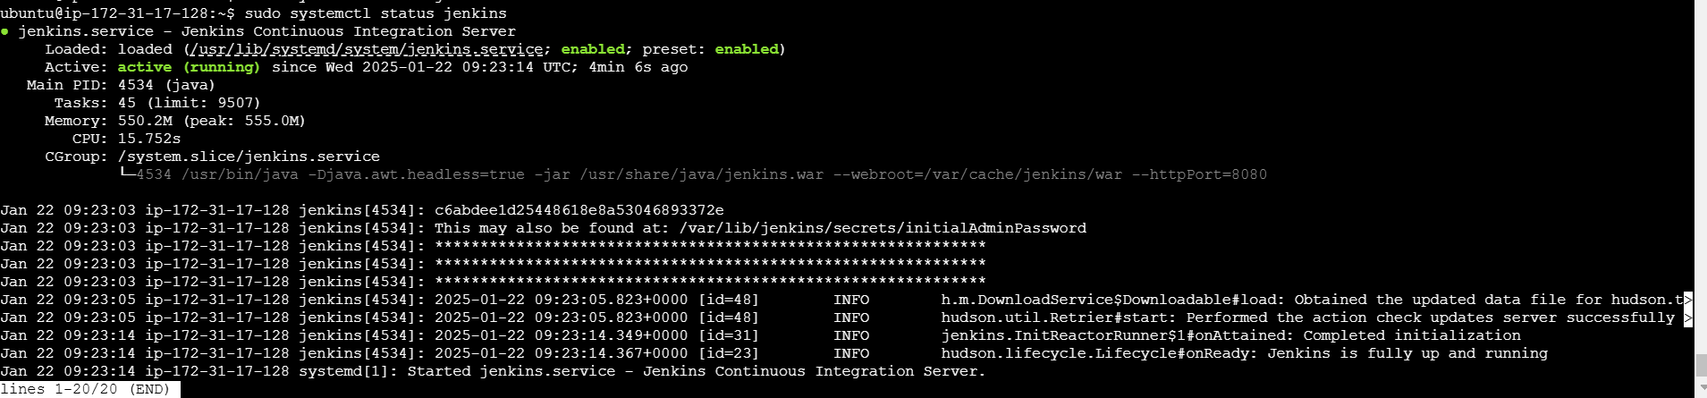
After starting the Jenkins need to checkstatus of Jnekins it is active or not by using
sudo systemctl status jenkins

Slide 19
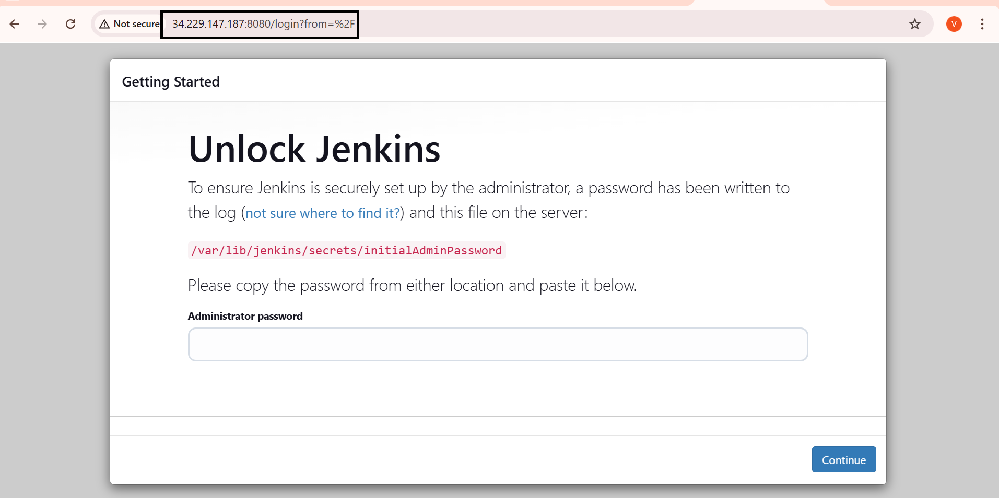
Then connect to the Jenkins dashboard by using Instance public IPV4 address:8080

Slide 20
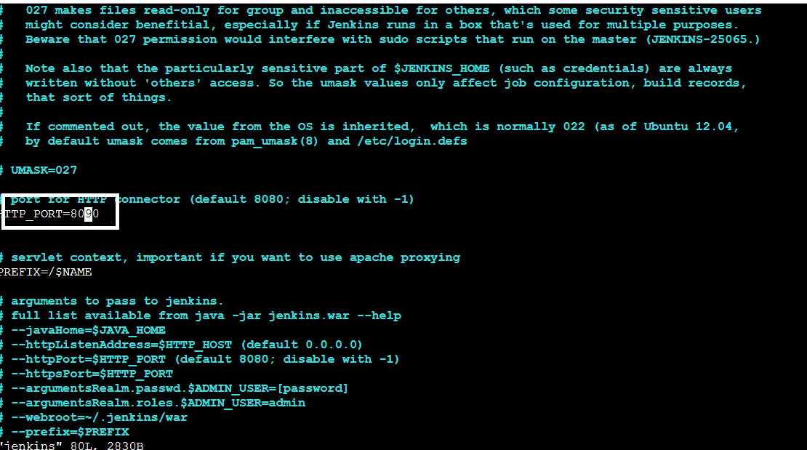
once Jenkins is installed and connected to dashboard then for this Application case, we are running Jenkins on another port. so change the port to 8090.
For changing to 8090 port first need to stop Jenkins by using
sudo systemctl stop jenkins
Then check the status of jenkins it is inactive or not by using
sudo systemctl status jenkins
Now we need to change the port to 8090 for that need to change the directory by using
cd /etc/default
After changing into directory need to go vi editor to change the port number by using
sudo vi jenkins

Slide 21
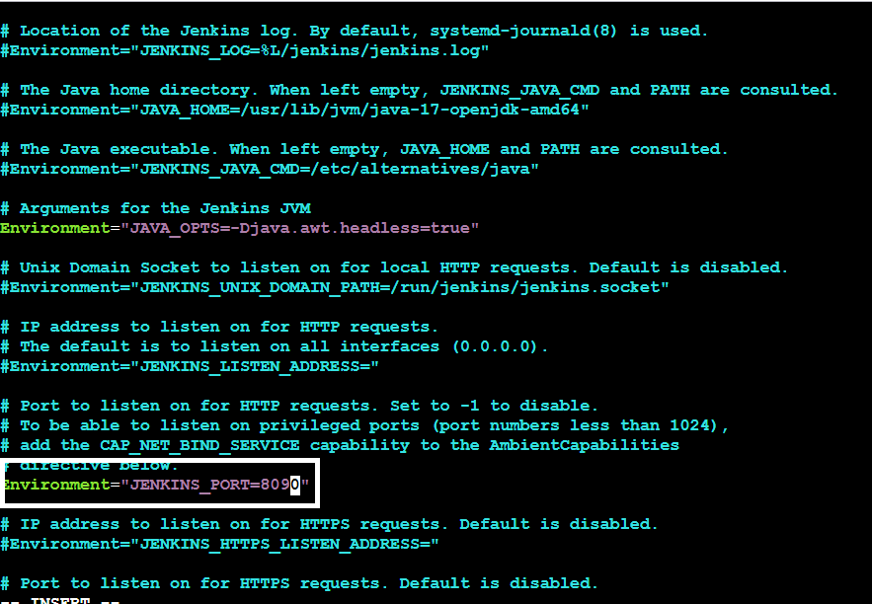
After exit from vi editor need to change to another directory by using
cd /lib/systemd/system
After changing into above directory need to got vi editor again by using sudo vi jenkins.service in this need to change the jenkins port to 8090 and then exit form vi editor

Slide 22
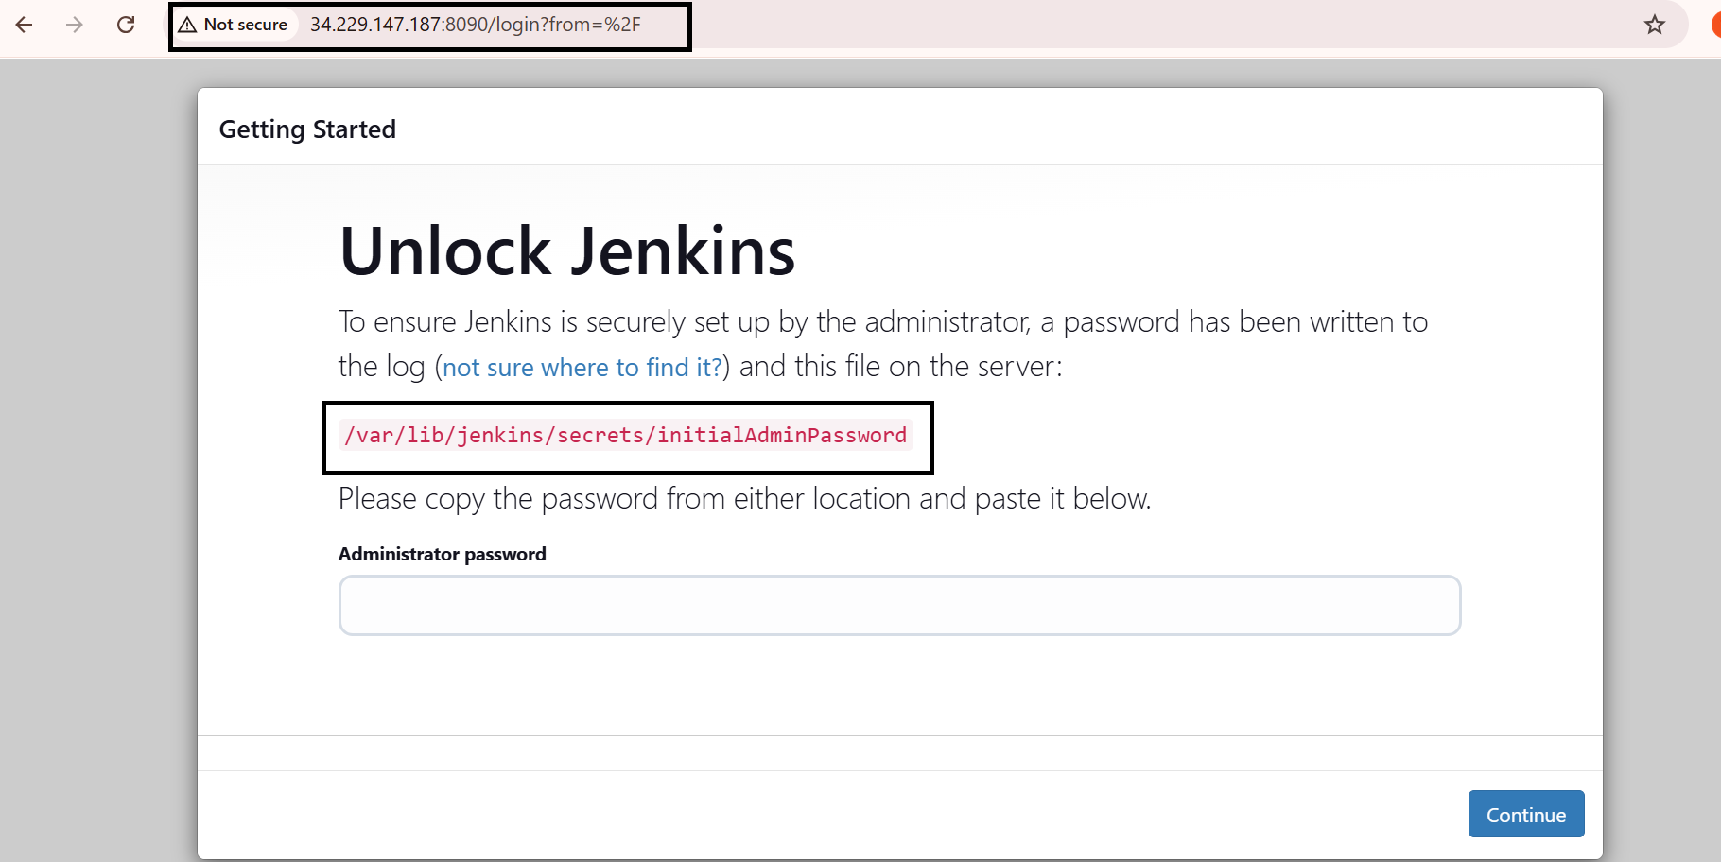
After exit from vi editor need to reload the jenkins server by using
sudo systemctl daemon-reload
Step-3:
Jenkins dashboard creation
Then restart the jenkins server by using
sudo systemctl restart jenkins
After restarting the service then connect the with 8090 port
Now Unlock Jenkins using an administrative password
To get need to copy var path and paste in Git by using sudo cat var path to get administrative password

Slide 23
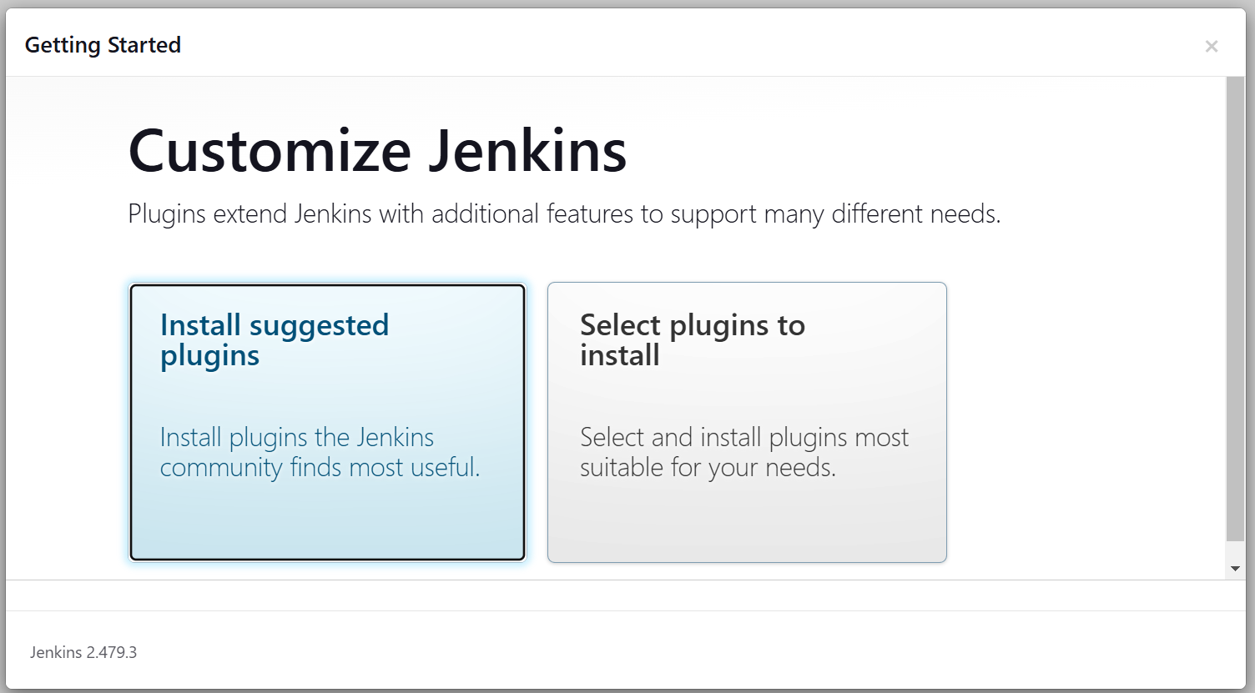
After unlocking the jenkins click on install the suggested plugins.

Slide 24
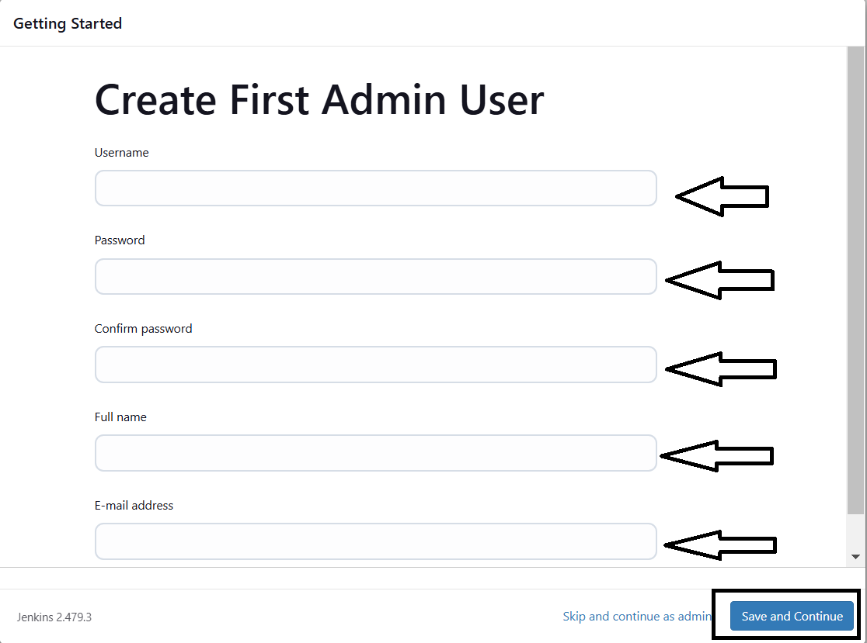
After successfully installation suggested we will get login page in that need to the enter below details
User name
Password
Conform Password
Full name
Email
After the all details need to
Click on save and continue
After click on save and
continue Jenkins dashboard
page will open

Slide 25
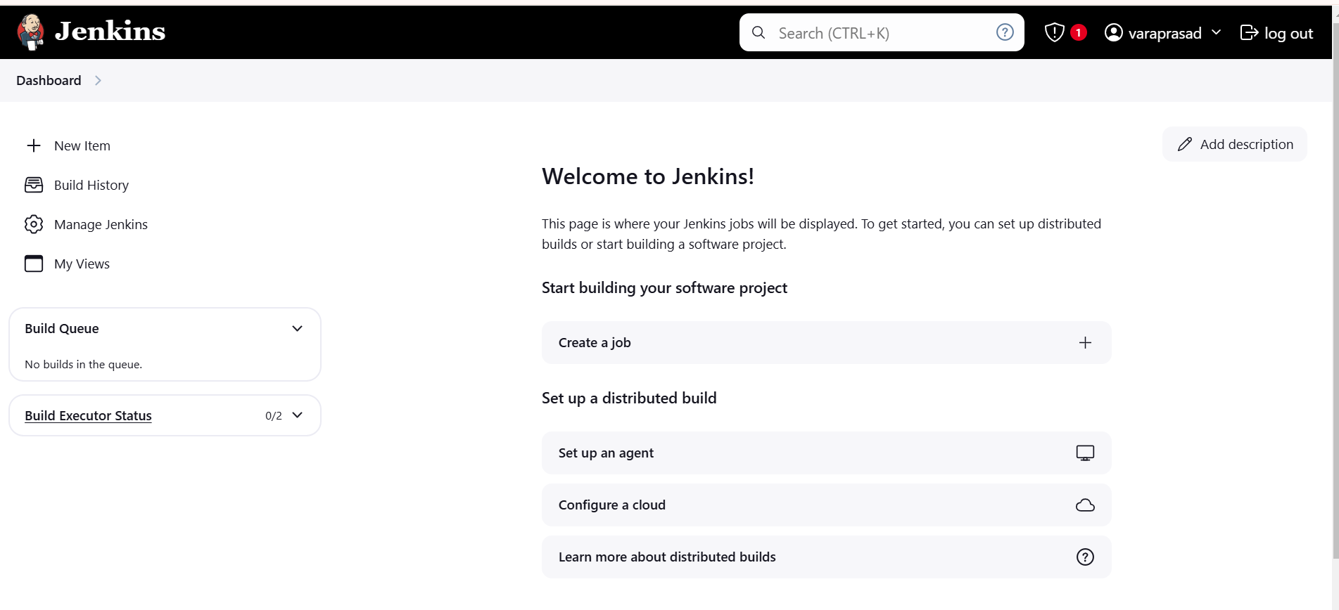
After created Jenkins Dashboard again got the Instance and install the docker

Slide 26
What is Docker?
Docker is an open-source platform that allows developers to automate the deployment, scaling, and management of applications inside lightweight, portable containers. These containers package an application with all its dependencies, ensuring that it runs consistently across different environments, such as development, testing, and production.
Step-4:
Need to Install Docker Instance and connect to the sonarQube with Docker Container by using below commands
sudo apt-get update
After update the tools need install Docker by using
sudo apt-get install docker.io -y
After Installing the docker create user in usermod by using
sudo usermod -aG docker $USER #my case is ubuntu
Then New group for docker by using
newgrp docker

Slide 27
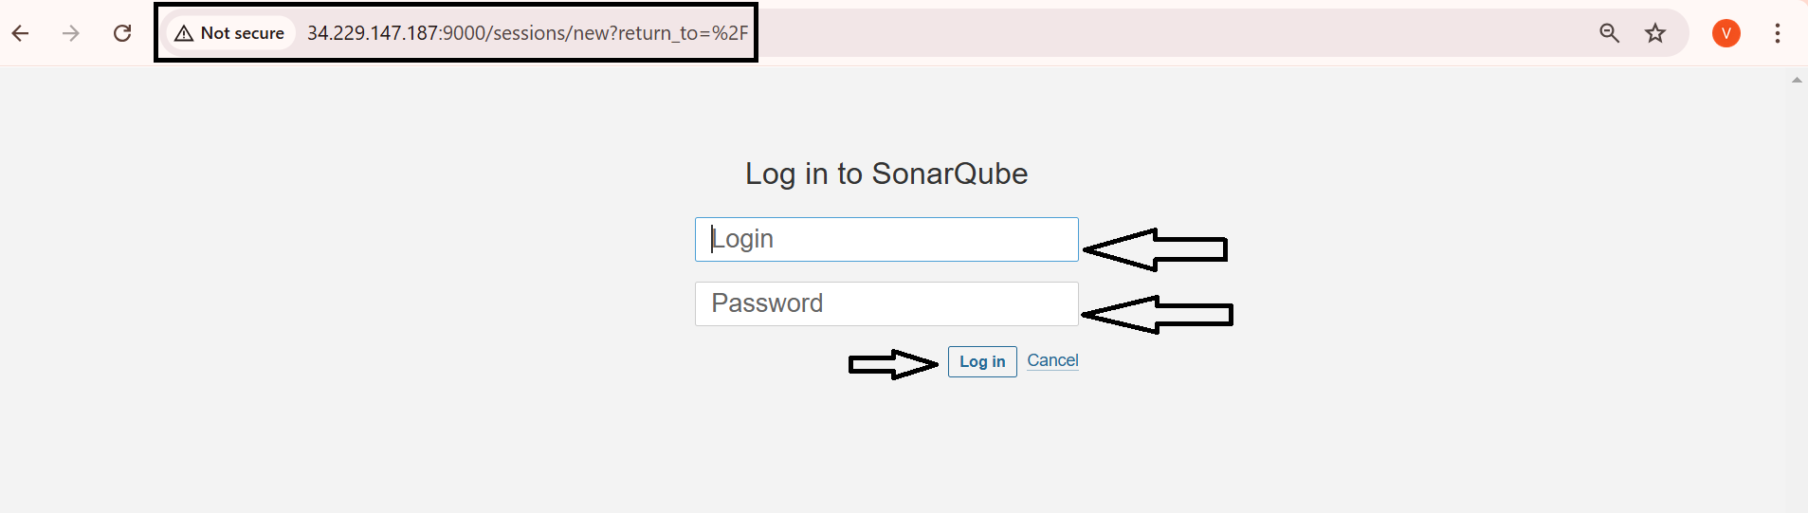
After the docker installation, we create a sonarqube container by using
docker run -d --name sonar -p 9000:9000 sonarqube:lts-community
Then connect the SonarQube by using Instance public IPV4address:9000 (SonarQube default port number)
Then login with login
Enter username as admin
Enter password as admin
Then click on login

Slide 28
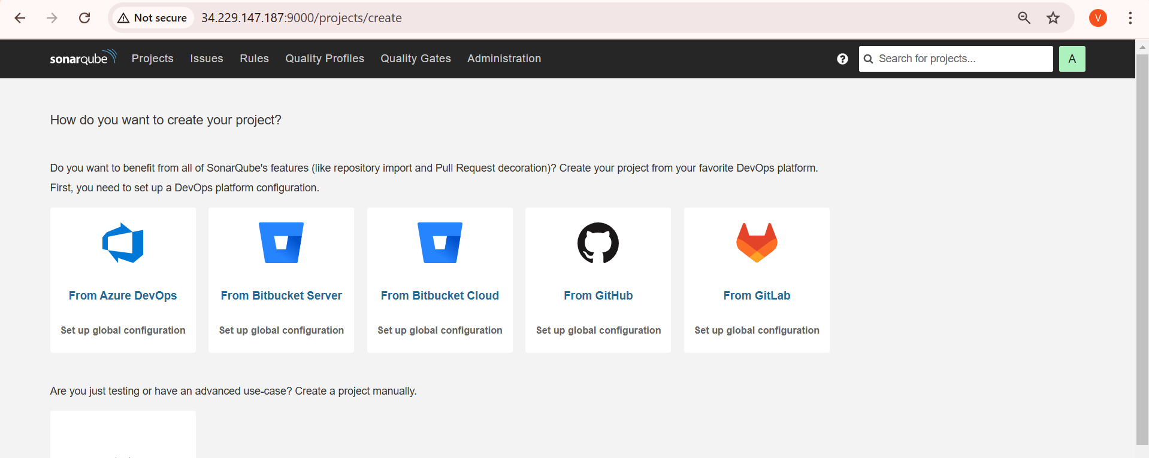
After click on the Login the SonarQube dashboard will open

Slide 29
What is trivy ?
Trivy is an open-source security scanner that helps DevOps teams identify vulnerabilities in containers and other artifacts. It's used to scan for vulnerabilities in container images, dependencies, and infrastructure as code (IaC).
How Trivy works.
Trivy uses a large vulnerability database to check for known Common Vulnerabilities and Exposures (CVEs).
Trivy scans the base image and its dependencies to provide a holistic view of the container's security status .
Trivy flags images with vulnerabilities that are classified as LOW, MEDIUM, HIGH, or CRITICAL.
Where Trivy is used.
Trivy is the default scanner for GitLab's Container Scanning functionality.
Trivy is used in Azure DevOps to scan container images for vulnerabilities .

Slide 30
Trivy Installation steps:
sudo apt-get install wget apt-transport-https gnupg lsb-release -y
wget -qO - https://aquasecurity.github.io/trivy-repo/deb/public.key | gpg --dearmor | sudo tee /usr/share/keyrings/trivy.gpg > /dev/null
echo "deb [signed-by=/usr/share/keyrings/trivy.gpg] https://aquasecurity.github.io/trivy-repo/deb $(lsb_release -sc) main" | sudo tee -a /etc/apt/sources.list.d/trivy.list
sudo apt-get update –y
sudo apt-get install trivy -y

Slide 31
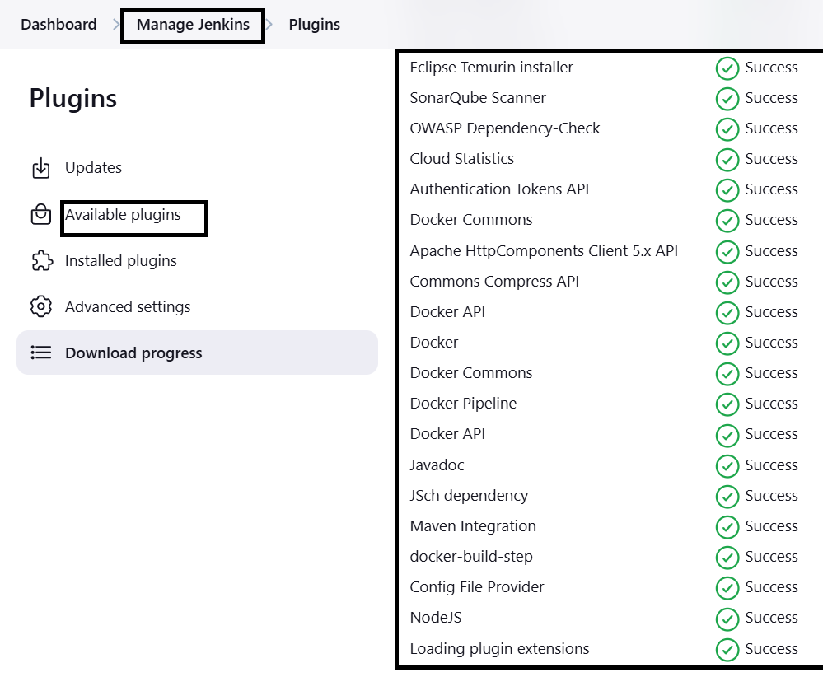
Step-5:
After completing of SonarQube connectivity need to go to the jenkins dashboard and start build the project
Step-6:
First login into Jenkins dashboard and the go to the manage Jenkins and select plugins in plugins need to select available plugins and install the required plugins
Eclipse Temurin Installer (Install without restart)
SonarQube Scanner (Install without restart)
Nodejs
Owasp
Docker
Docker build-step
Docker commons
Docker pipeline

Slide 32
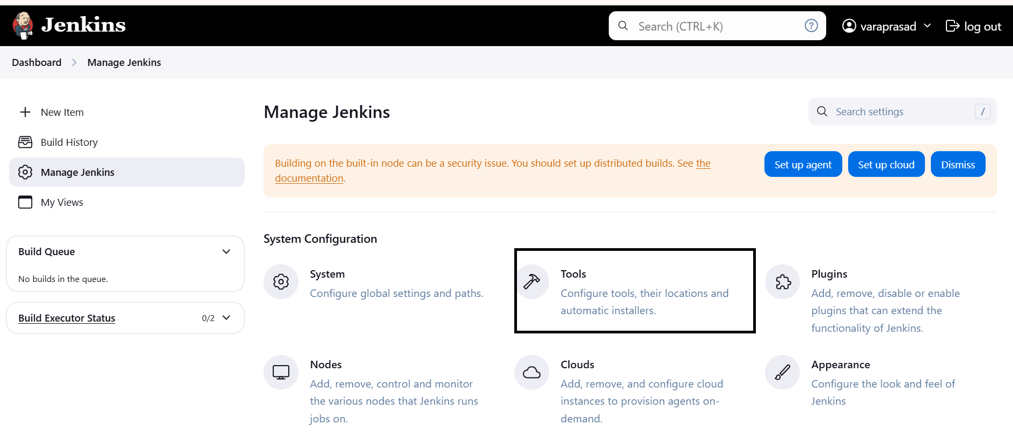
Step-9:
Then again go to the Manage Jenkins and select Tools.

Slide 33
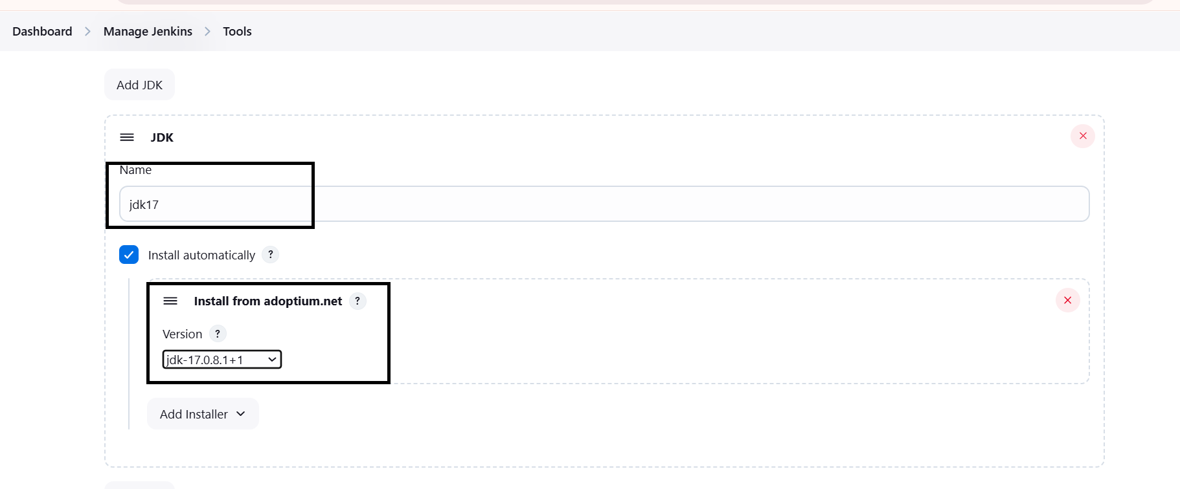
In Tools need to add jdk installation and maven installation
Add jenkins Installation
Name
Java Version (jdk-17.0.8.1+1)

Slide 34
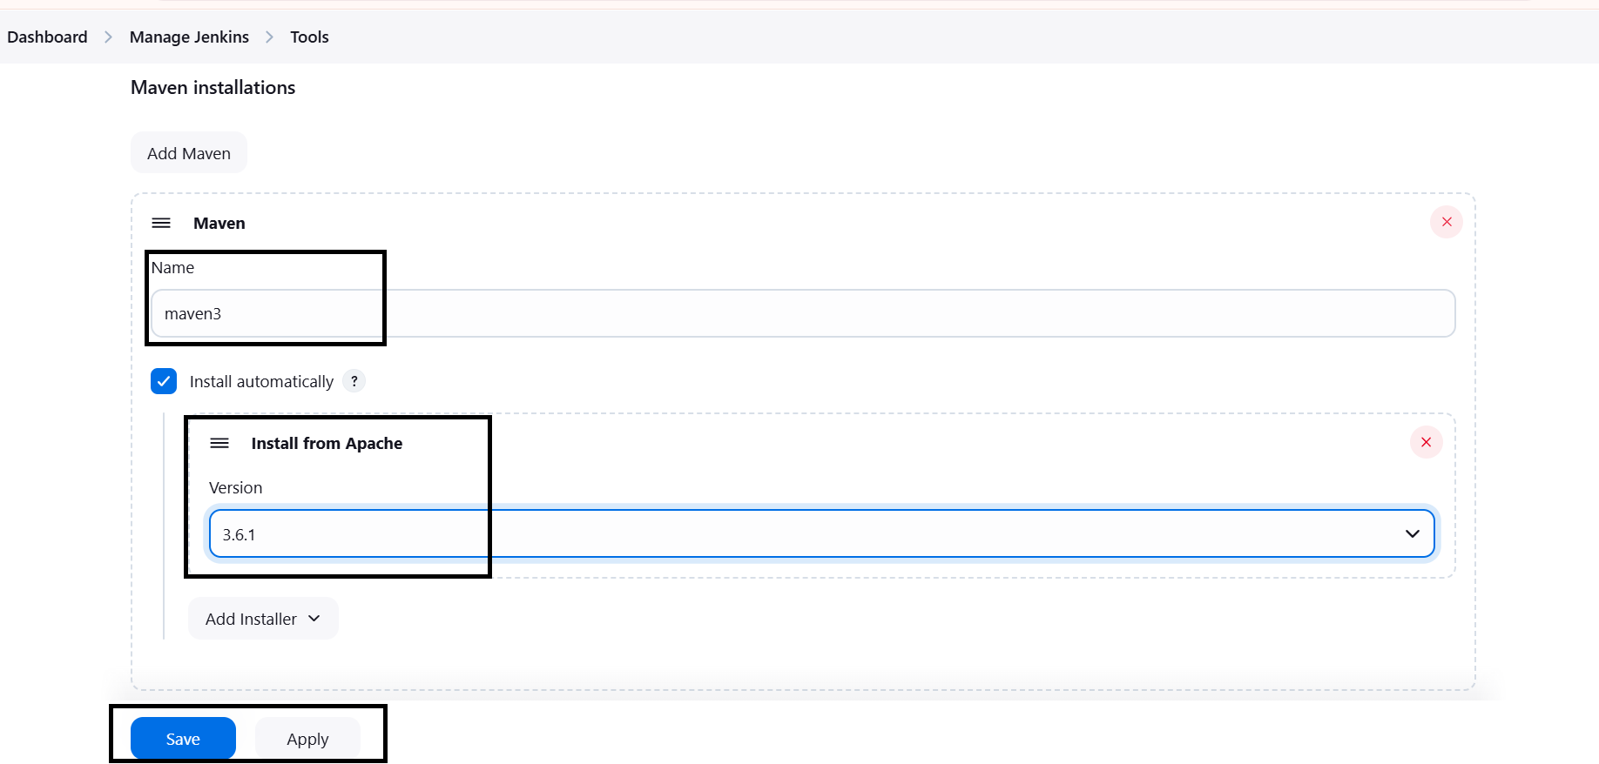
Then again In Tools need to add maven installation and maven installation.
Add maven
Name
Maven Version (3.6.0)

Slide 35
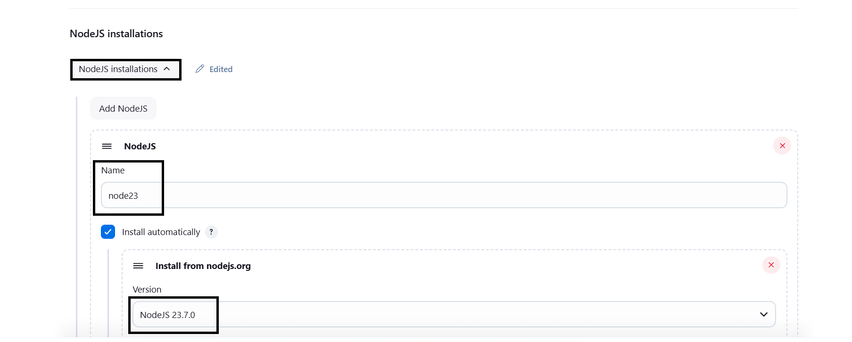
Add Nodejs its shown below

Slide 36
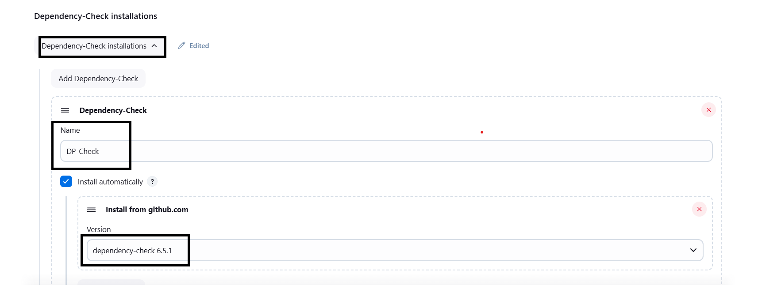
Owasp tool add its shown below .
And next apply and save.

Slide 37
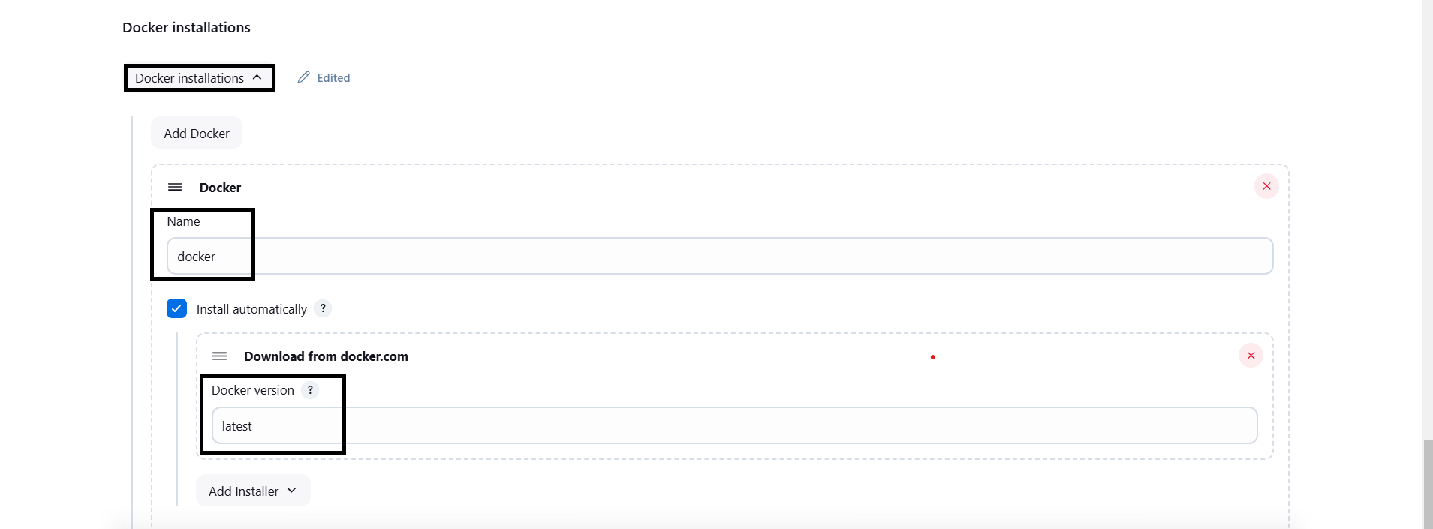
Docker tool add its shown below.

Slide 38
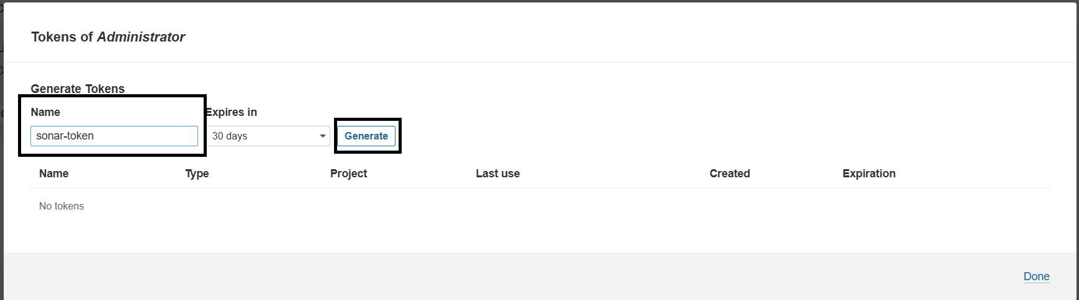
Step-10:
Configure Sonar Server in Manage Jenkins
Create a token with a name and generate:

Slide 39
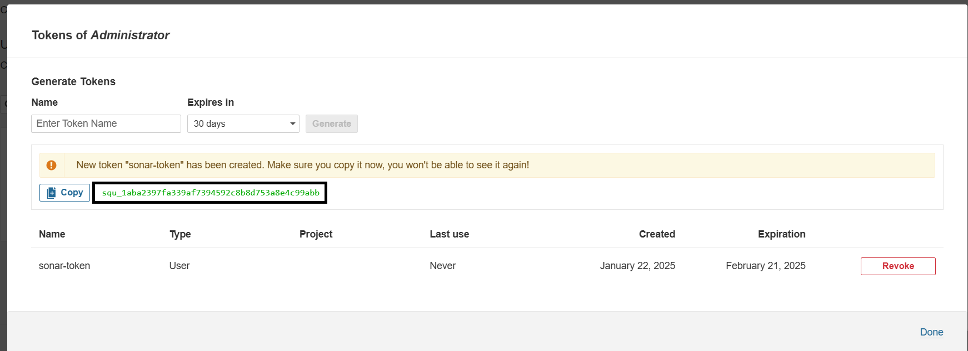
Copy token:

Slide 40
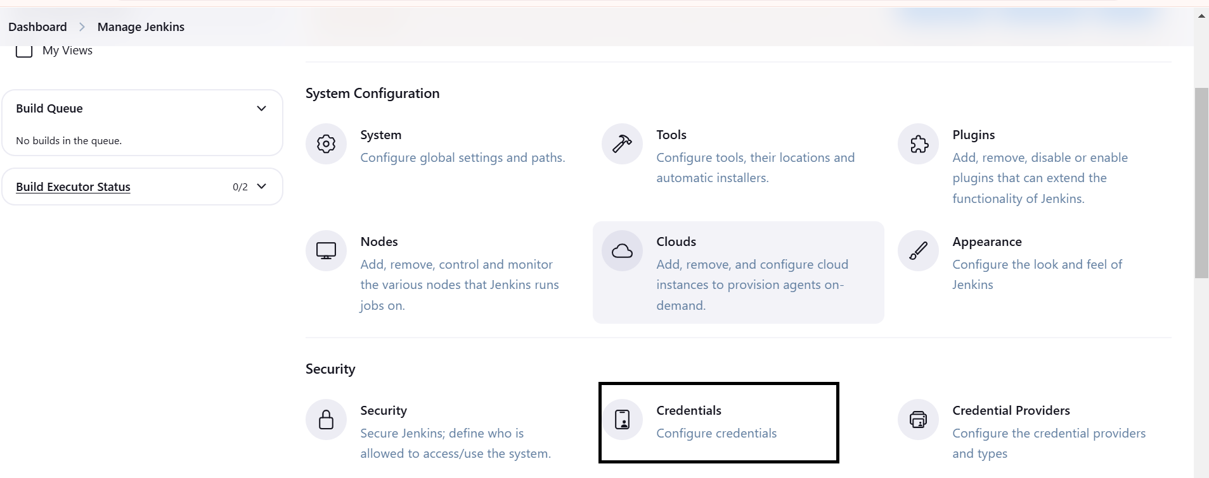
Go to Jenkins Dashboard → Manage Jenkins → Credentials

Slide 41
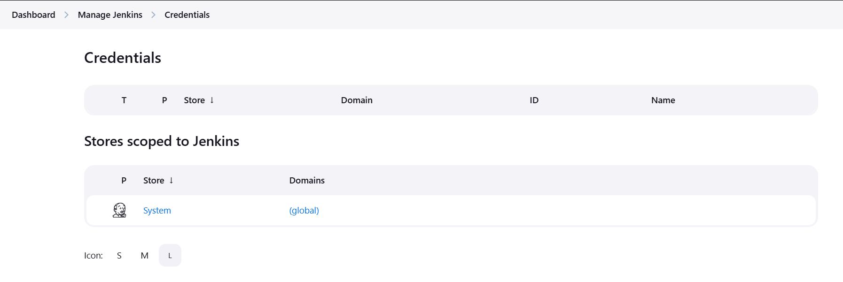
In credentials click on global :

Slide 42
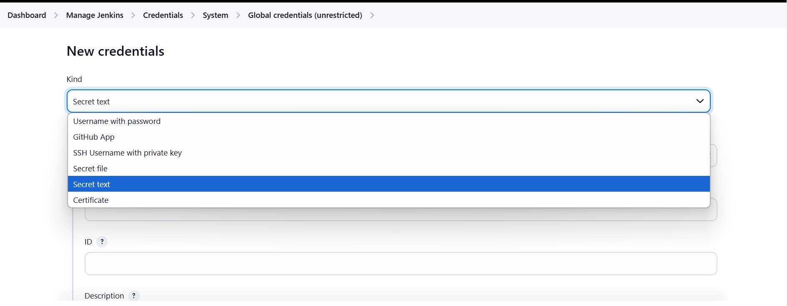
Add Secret Text:

Slide 43
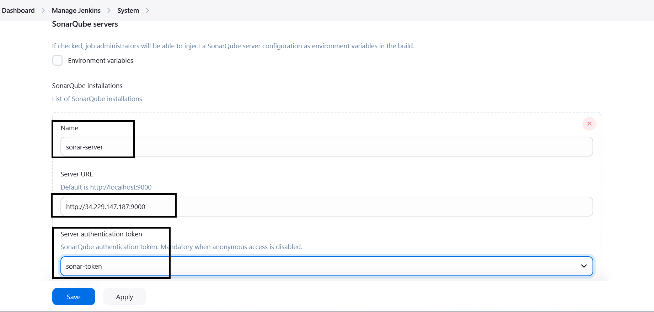
Now, go to Dashboard → Manage Jenkins → System
Here give name and paste url of sonar cube.

Slide 44
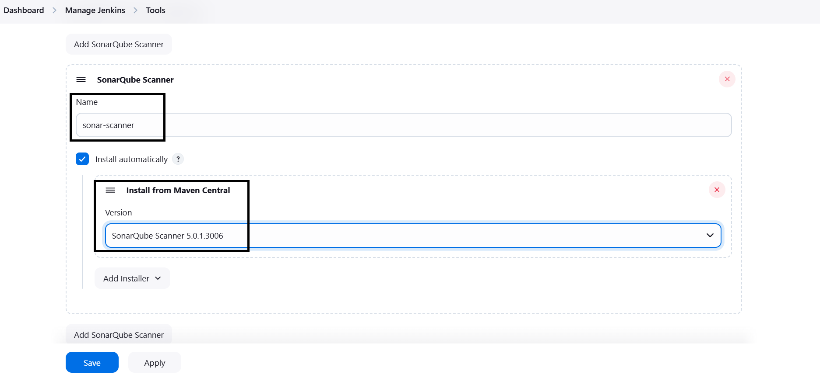
The Configure System option is used in Jenkins to configure different server
Global Tool Configuration is used to configure different tools that we install using Plugins
We will install a sonar scanner in the tools.

Slide 45
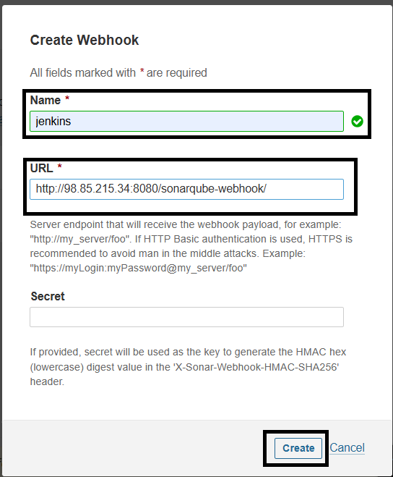
In the Sonarqube Dashboard add a quality gate also
Administration--> Configuration-->Webhooks

Slide 46
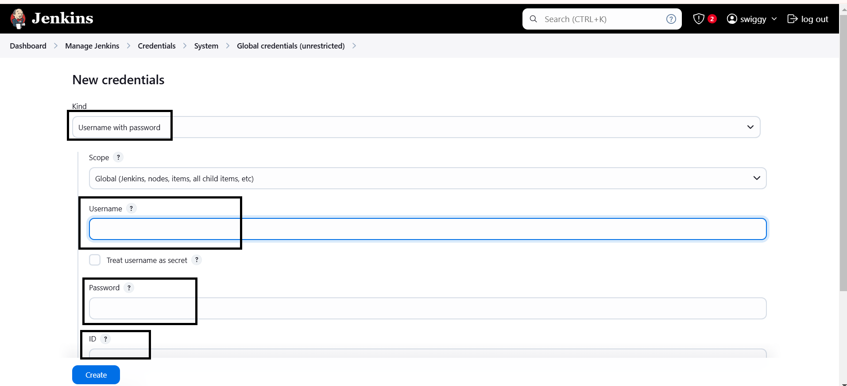
Step 11:
Add Dockerhub credentials go to manage Jenkins—credentials—system(global) its shown below.
In the kind (select usrname with passwd),give you Dockerhub (username&passwd),&ID(name).
And next click on create.

Slide 47
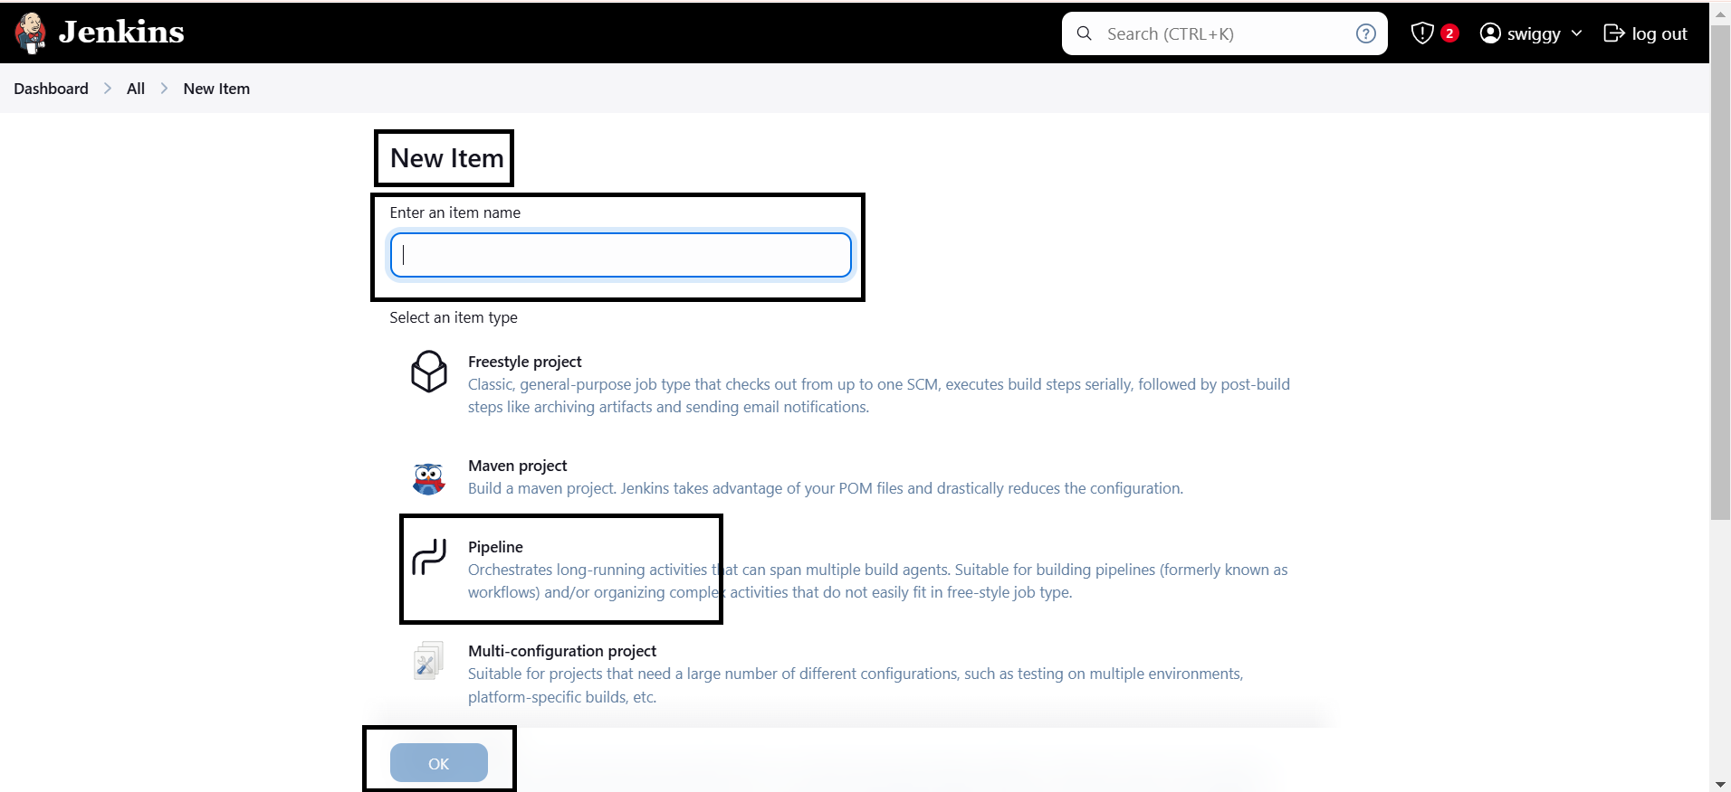
After providing all the information need to Create a new project with Pipeline.
Go to Jenkins dashboard and select New item , and create a pipeline.

Slide 48
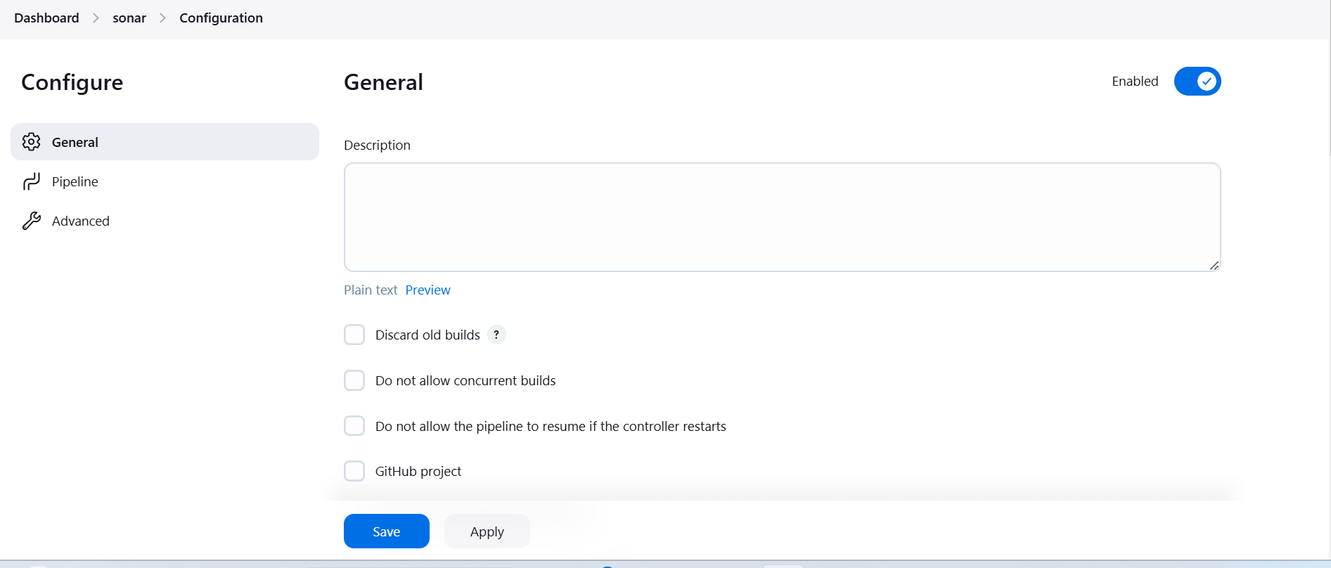
After Click on Ok the configure page will open
In General Tab need to provide the decesription

Slide 49
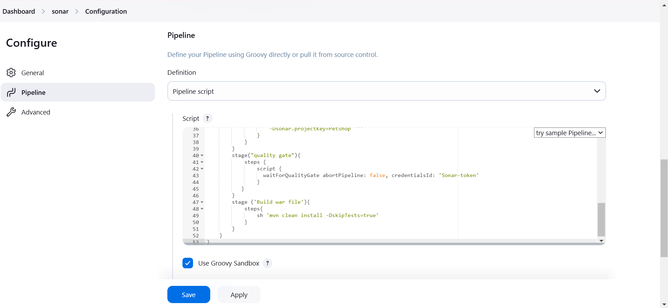
Then go the Pipeline in Configure and then provide the pipeline script Then Apply and Save.

Slide 50
In the pipeline script I can build a SWIGGY-APP here is the shell script its given below:
pipeline{
agent any
tools{
jdk 'jdk17'
nodejs 'node23'
}
environment {
SCANNER_HOME=tool 'sonar-scanner'
}
stages {
stage('clean workspace'){
steps{
cleanWs()
}
}

Slide 51
stage('Checkout from Git'){
steps{
git 'https://github.com/prasad234567/My-DevOps-Project-Swiggy.git'
}
}
stage("Sonarqube Analysis "){
steps{
withSonarQubeEnv('sonar-server') {
sh ''' $SCANNER_HOME/bin/sonar-scanner -Dsonar.projectName=swiggy-app \
-Dsonar.projectKey=swiggy-app '''
}
}
}
stage("quality gate"){
steps {
script {
waitForQualityGate abortPipeline: false, credentialsId: 'sonar-token'
}
}
}

Slide 52
stage('Install Dependencies') {
steps {
sh "npm install"
}
}
stage('OWASP FS SCAN') {
steps {
dependencyCheck additionalArguments: '--scan ./ --disableYarnAudit --disableNodeAudit', odcInstallation: 'DP-Check'
dependencyCheckPublisher pattern: '**/dependency-check-report.xml'
}
}
stage('TRIVY FS SCAN') {
steps {
sh "trivy fs . > trivyfs.txt"
}
}

Slide 53
stage ('Docker Login'){
steps {
withCredentials([usernamePassword(credentialsId: 'docker-creds', passwordVariable: 'mypasswd', usernameVariable: 'usr')]) {
sh "docker logout"
sh "echo ${mypasswd} | docker login -u ${usr} --password-stdin"
}
}
}
stage ('Built Docker') {
steps {
sh "docker build -t swiggy-app ."
sh "docker tag swiggy-app varaprasad372/swiggy-app:latest"
}
}
stage ('Push to dockerhub') {
steps {
sh "docker push varaprasad372/swiggy-app:latest"
}
}

Slide 54
stage("TRIVY"){
steps{
sh "trivy image varaprasad372/swiggy-app:latest > trivy.txt"
}
}
stage('Deploy to container'){
steps{
sh 'docker run -d --name swiggy-app -p 3000:3000 varaprasad372/swiggy-app:latest'
}
}
}
}

Slide 55
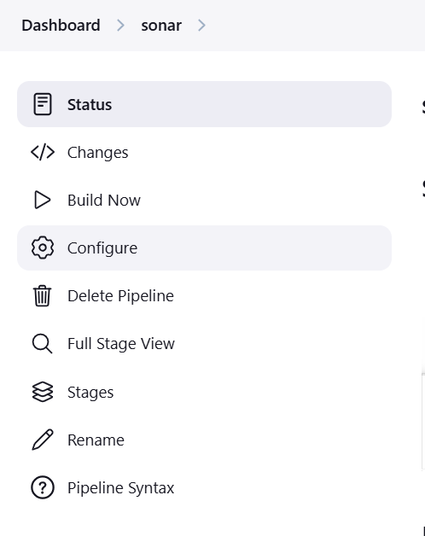
After save the configure page then click on Build Now

Slide 56
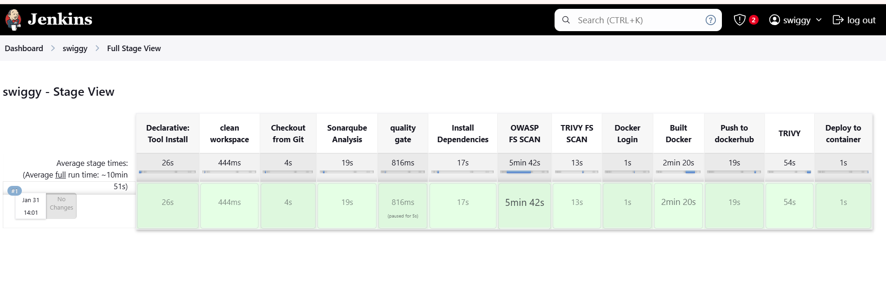
After Click on Build Now you will get success output its shown below.

Slide 57
Sonar analysis:
Sonar analysis typically refers to the use of sonar technology to analyze and map underwater environments. Sonar, which stands for Sound Navigation and Ranging, works by emitting sound waves and then measuring the time it takes for those waves to bounce back after hitting an object or surface. This information is used to create maps of the seabed, detect underwater objects, and analyze water conditions.
There are a couple of primary types of sonar analysis:
Active Sonar:
The sonar system sends out a pulse or sound wave and waits for it to bounce back from objects. This is commonly used for mapping the ocean floor or locating objects.
Passive Sonar:
This type listens to the sounds already present in the water, such as from marine life, ships, or other activities. It's often used for surveillance or to detect underwater activity.
Sonar is widely used in a variety of fields, including oceanography, marine biology, underwater navigation, military applications (like submarines), and for detecting things like shipwrecks or underwater geological features.

Slide 58
Quality gate:
A quality gate is a set of criteria or rules used to assess the quality of code or software at specific points in the development process. It’s most commonly used in software development and continuous integration (CI) practices to ensure that only high-quality code makes it through to the next stage of the development cycle.
In tools like SonarQube (a popular code quality analysis tool), a quality gate is essentially a set of conditions that must be met for the code to be considered "acceptable." If the code doesn't meet these conditions, it is flagged, and further action (like fixing issues) is required before proceeding.
Key components of a quality gate can include:
Code coverage: A percentage of the code that is covered by automated tests. For example, a quality gate might require at least 80% of the code to be covered by tests.
Code duplications: Limiting the amount of duplicated code in the system, as excessive duplication can lead to maintenance problems.
Bug count: Ensuring that no new critical or major bugs are introduced.
Code smells: Ensuring that the code doesn’t introduce unnecessary complexity or poor practices that could harm maintainability.
Security vulnerabilities: Ensuring that no security issues are present in the codebase.

Slide 59
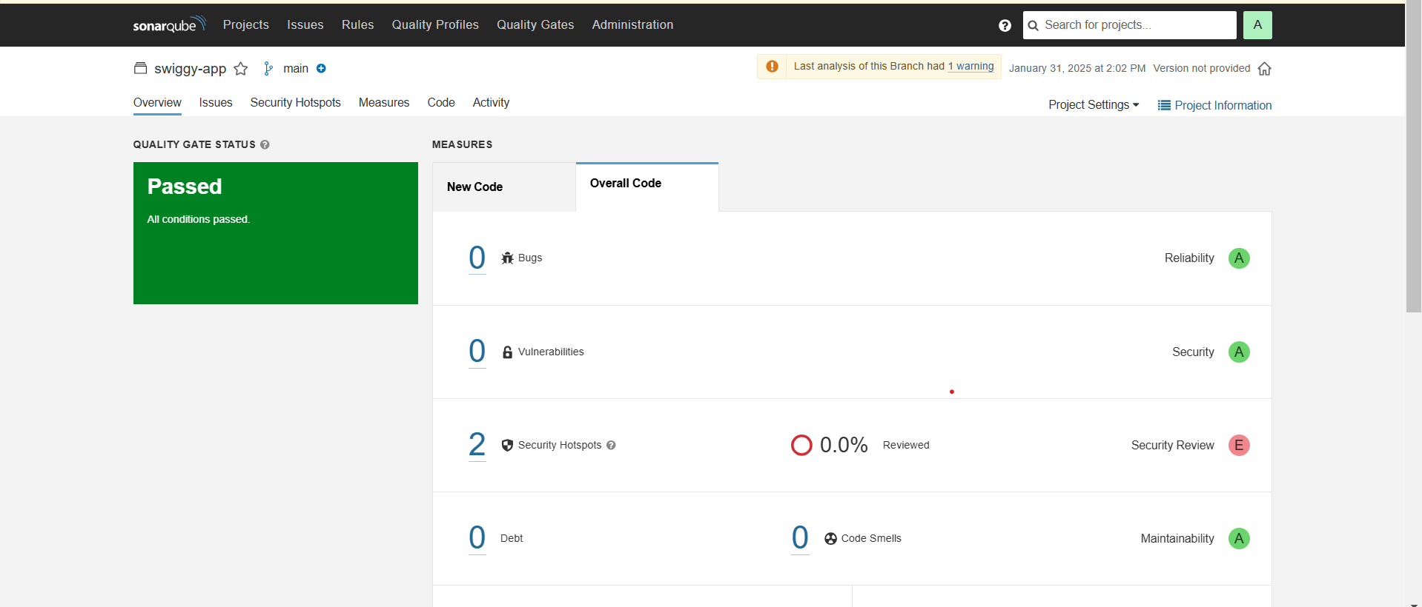
After success sonar analysis go to sonarqube , in sonarqube we build SWIGGY-APP project ,Here we find quality gate status and 0 bugs is shown below.

Slide 60
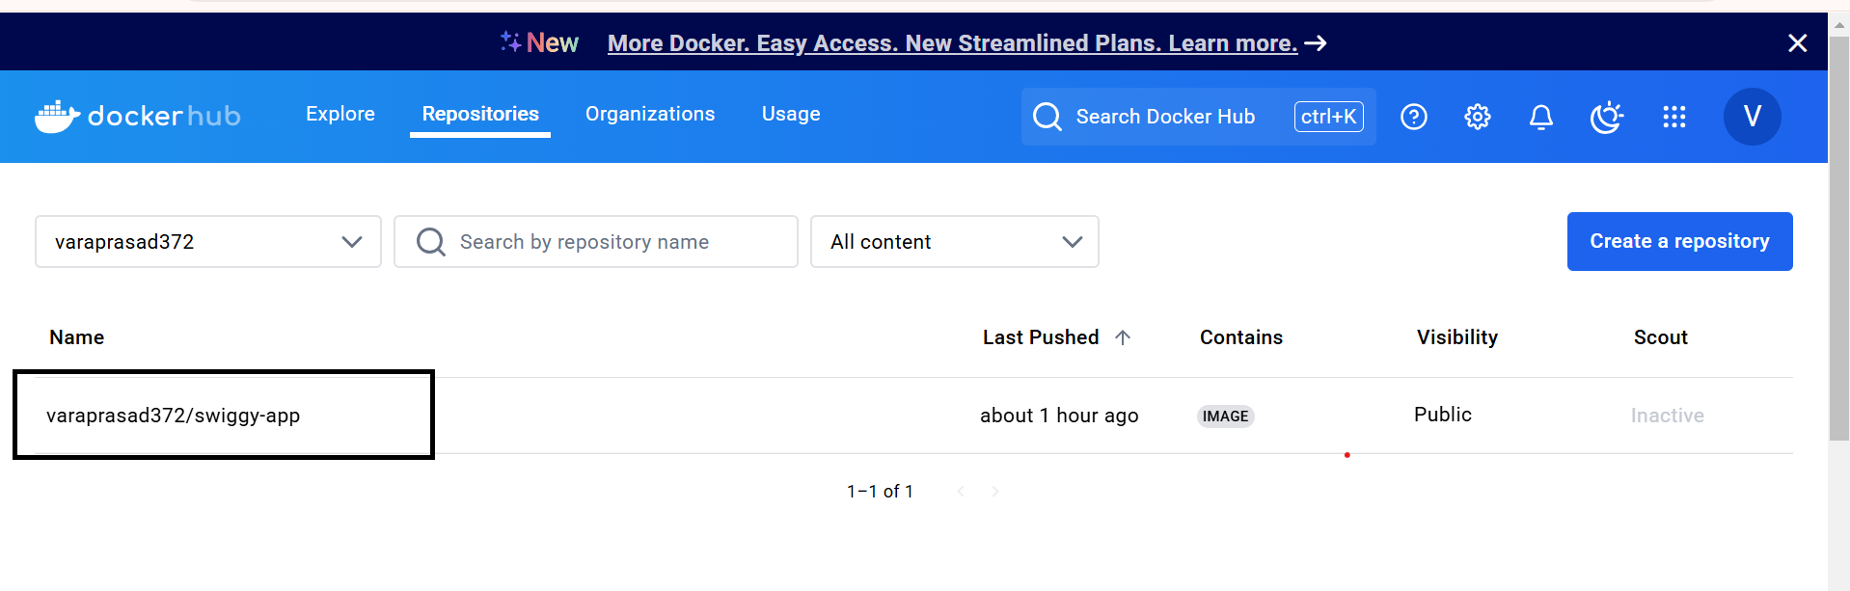
And next go to Dockerhub login with your own credentials there Repositories has been created its shown below:

Slide 61
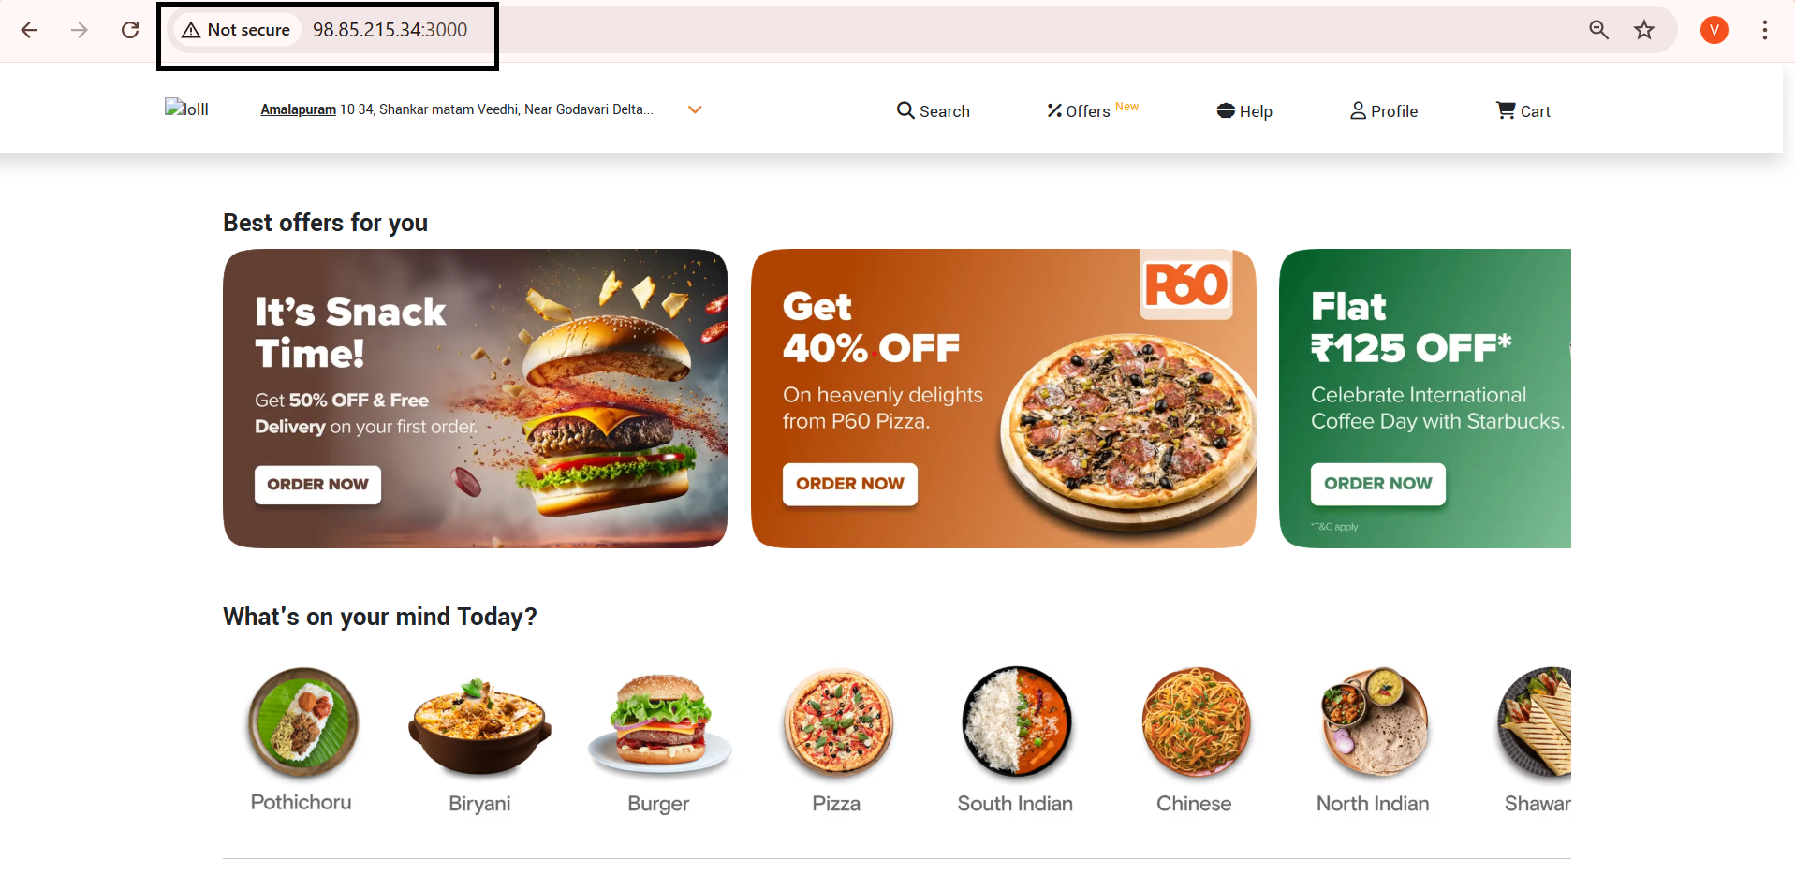
After successful SWIGGY-APP application .
Go to newtab , give public ip:3000 , then open SWIGGY-APP its shown below.

Slide 62


